Slide 1

Developing enterprise-level IoT Solutions using Continuous Engineering tools and practice
Daniel Moul & Fariz Saracevic Watson IoT CE Senior Offering Managers IBM
Session Io04

Slide 2
IoT opportunities … and challenges
What should we do?
How should we do it?

Slide 3


“We need to be able to …”
Depend on our IoT solution
Innovate faster than our competitors
Notes:
Image: https://commons.wikimedia.org/wiki/File:Farm-Fresh_check_box.png

Slide 4
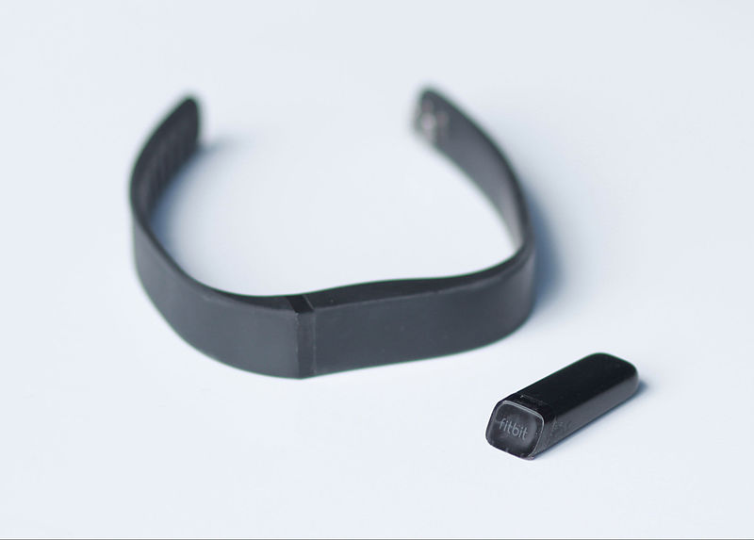
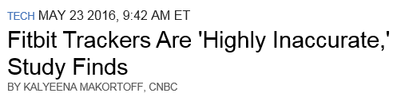
Some IoT devices emit data (sensors → telemetry)
Lawsuit claims FitBit devices dangerously underestimate heart rate
Three plaintiffs say FitBits fail during exercise, worthless as heart monitors.
-ARS Technica Jan 6, 2016
“… Fitbit devices miscalculated heart rates by up to 20 beats per minute on average during more intensive workouts.”
Notes:
FiBit is finding that being fast to market and building market share are not enough.
Now they are facing legal risks and actual customer safety risks.
Their development practices will need to change address these risks.
Sources:
http://arstechnica.com/tech-policy/2016/01/lawsuit-claims-fitbit-devices-dangerously-underestimate-heart-rate/ (will people with heart or blood problems over-exert themselves?)
http://www.nbcnews.com/tech/gadgets/fitbit-trackers-are-highly-inaccurate-study-finds-n578631

Slide 5
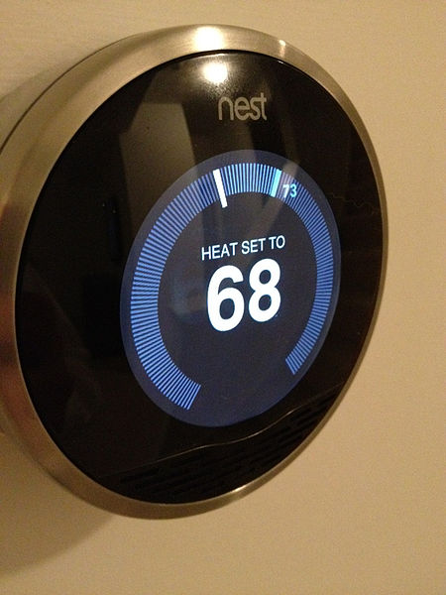
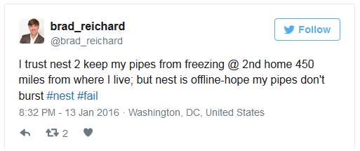
Some IoT devices do something (actuators → behavior)
Nest thermostat bug leaves owners without heating
-The Stack Jan 14, 2016
Notes:
In this case a simple device like a Nest thermostat put owners at risk of many thousands of dollars of damages to their homes.
The problem was not the hardware or the primary software. It was the software update process.
It seems there was a gap in the systems engineering – thinking about the solution end-to-end, the emergent behavior when all the parts interact, and the new kinds of failure modes this introduces.
And it seems there was a gap in verifying new system behavior before delivering changes.
The Nest device has only one or two electronic switches.
What if your IoT devices have more than two? What if there are 20, 200 or 2000?
When you are designing for an IoT you need to think differently.
See www.ecnmag.com/blog/2016/04/what-internet-things-needs-systems-engineering
See http://www.telegraph.co.uk/technology/news/12099033/Nest-thermostat-owners-left-without-heating-after-software-glitch.html

Slide 6
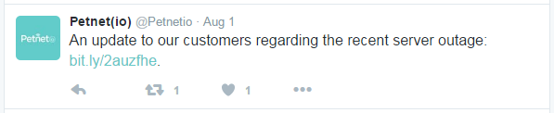
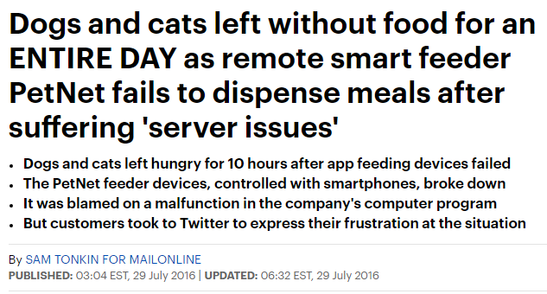

IoT pet feeder: What could go wrong?
To our loyal Petnet family,
As you may know, our third-party servers suffered an outage late Wednesday evening, which temporarily disabled the ability to remote feed and edit feeding schedules for about 10 percent of our users. We immediately became aware of the issue and were back up and running in about eight hours. We sincerely apologize for any issues this may have caused.
As pet parents ourselves, we recognize that when it comes to our pets, even one hour is too long to wait when it’s time for a feeding. That’s why we were already working on a solution to prevent this issue from happening. The fix was ready, but still needed to be tested when this outage occurred. Our engineers were prepared to implement the solution and get your SmartFeeders back online as quickly as possible. Now that this update has been made, our platform is stronger and more reliable than ever. We have two fail-safes in place, making it virtually impossible for this to happen again and ensuring your pets will always be fed…
http://www.dailymail.co.uk/news/article-3714186/Dogs-cats-left-without-food-remote-smart-feeder-PetNet-fails-dispense-meals-suffering-server-issues.html
http://bit.ly/2auzfhe
Notes:
In this case a simple device like a Nest thermostat put owners at risk of many thousands of dollars of damages to their homes.
The problem was not the hardware or the primary software. It was the software update process.
It seems there was a gap in the systems engineering – thinking about the solution end-to-end, the emergent behavior when all the parts interact, and the new kinds of failure modes this introduces.
And it seems there was a gap in verifying new system behavior before delivering changes.
The Nest device has only one or two electronic switches.
What if your IoT devices have more than two? What if there are 20, 200 or 2000?
When you are designing for an IoT you need to think differently.
See www.ecnmag.com/blog/2016/04/what-internet-things-needs-systems-engineering
See http://www.telegraph.co.uk/technology/news/12099033/Nest-thermostat-owners-left-without-heating-after-software-glitch.html
Image: https://commons.wikimedia.org/wiki/File:EnglishMastiffSleeping.jpeg

Slide 7
How much dependability do you really need?
What kinds of dependability do you really need?
Availability
Reliability
Safety
Security
Engineering effort per feature
C
Cost of failure
B
A
Development Velocity

Slide 8
The only way to win is to learn faster than anyone else.
–Eric Ries, The Lean Startup: How Today's Entrepreneurs Use Continuous Innovation to Create Radically Successful Businesses

Slide 9





Learn and innovate faster with an IoT feedback loop
Analyze data to inform
Cognitive Analytics
Analyze
Operate
Business Leaders, Engineers and Developers
IoT-enabled
products/systems
Manage
Requirements
Build and Deploy
Design
System
Verify and Validate
Manage Development
Continuous Engineering
Design and develop products/solutions

Slide 10
Continuous Engineering for IoT Solution Details
IBM IoT Continuous Engineering environment
IBM Bluemix
Continuous Engineering tools
OSLC adapter
IoT Dashboard (Custom)
IoT Platform
IoT platform device definitions
IoT platform rules
Node-RED flows
Low Flow machines (IoT Devices)

Slide 11
Demo

Slide 12
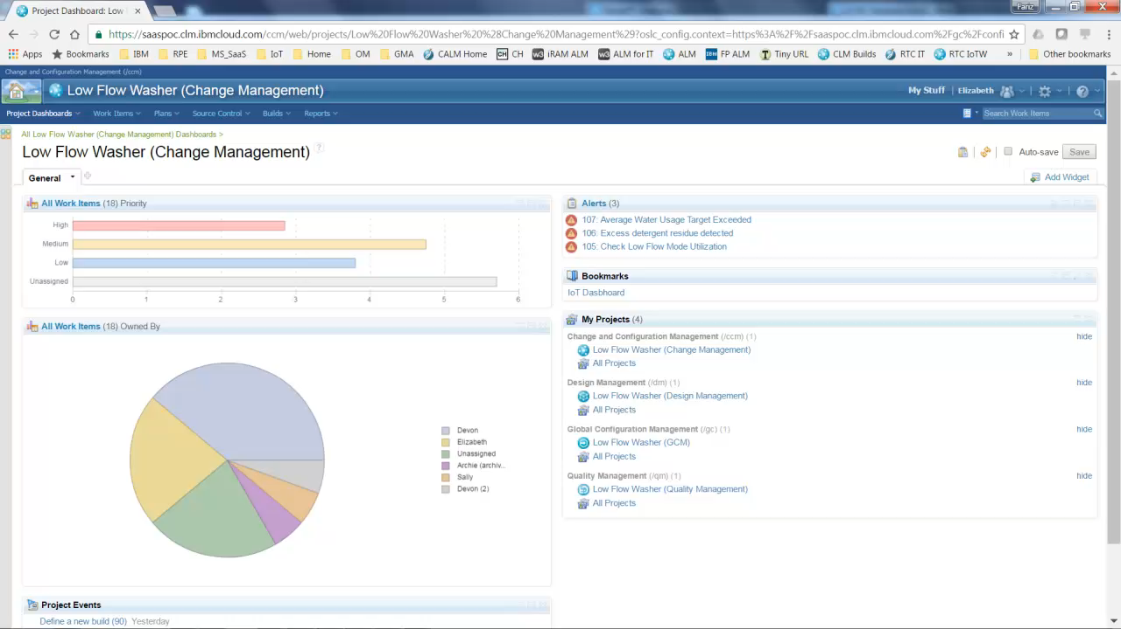

Slide 13




What we saw
Engineering team “designed IoT in”
Designed for operational feedback and analysis
Engineering team detected problem and responded quickly
Combining engineering and operational information
Business manager used IoT data to confirm that problem was fixed
Sentiment analysis and user behavior data
Team solved problem with a remote software update
No service visits needed
Notes:
The engineering team “designed IoT in”
Designed for analytics: team thought about KPIs, statistics, data, and sensors needed
Enabled feedback with automated alerts and IoT Dashboard
Addressed all components of the system
The engineering team detected issue and responded quickly
Received automated alert
Found root cause by combining engineering and operational information
Had fix ready before significant adverse affect (customer dissatisfaction, warranty claims, product returns)
The business manager utilized IoT data to confirm that problem was fixed
Sentiment analysis and user behavior data
JKE Appliances used social media to measure the effectiveness of the solution
Invited their customers to tweet their experience
The problem was addressed with a remote software update
No service calls needed

Slide 14
Not shown: extensions to the scenario that can improve product quality and team productivity
Improve test coverage with automated testing
Functional testing of solution …
Components on-device and in the cloud
Scenarios across the solution components
Simulation of devices and services not yet available
Performance testing devices and the system

Slide 15
Not shown: extensions to the scenario that can improve product quality and team productivity (2)
Find problems faster with continuous delivery pipeline
Automated build / deploy / test
Components and cross-component scenarios
Bonus: makes it easy to create test environments

Slide 16
Not shown: extensions to the scenario that can improve design
Improve testing and design assumptions
Compare test results in the lab with real-word operational data (including failures)
Analyze warranty and service call data to improve design

Slide 17
Not shown: extensions to the scenario that can improve design (2)
Model-based engineering (MBE)
Systems engineering (MBSE) and Model-driven development (MDD)
Define complex systems in models using multiple viewpoints (e.g., business, user, functional, implementation)
Design device state machines, logic, and system interactions
Validate designs in simulated software or virtual HW+SW
Models → code

Slide 18
With thanks to Persistent Systems Ltd – IoT Flywheel services
Used in this demo:
IoT Dashboard
Not shown
Work item creator
RQM test execution adapter
Innovation sandbox
Reference implementation of IoT Flywheel, for production-grade Watson IoT on Bluemix
From data collection to useable applications
2-3 month engagement
Delivered by IBM and Persistent professional services
Agile dev with mutually-agreed upon sprint schedule
Decision support
Advice on enterprise-wide deployment architecture
Proposal for phased development and operations

Slide 19
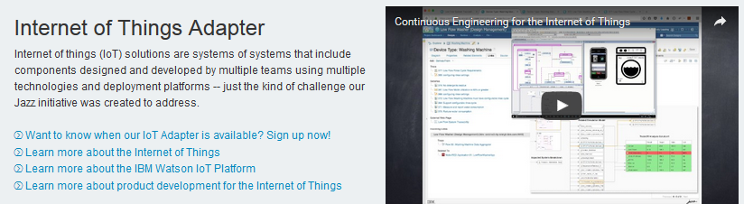
OSLC Adapter
https://jazz.net/products/iot-adapter/

Slide 20
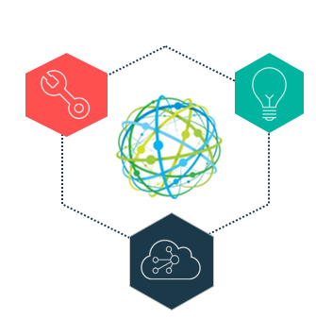
Thank You

Slide 22
Bonus charts (Backup)

Slide 23


Scenario overview: Keep a business initiative on track with IoT feedback
IoT-connected machines are in operation
Engineering team receive system-generated alert when operational performance does not match specification
Bob
Business Manager
Engineering team finds likely cause and proposes solution
Business manager reviews and approves
Engineering team implements and tests the changes
Machines’ embedded software is remotely updated
Elizabeth Engineering
Manager
Customers receive an alert about the new configuration option through a pop-up message on their machine’s touch screen
After a few weeks, the Business Manager checks customers’ behavior on the product dashboard and is happy to see that customers are now using the feature as expected

Slide 24
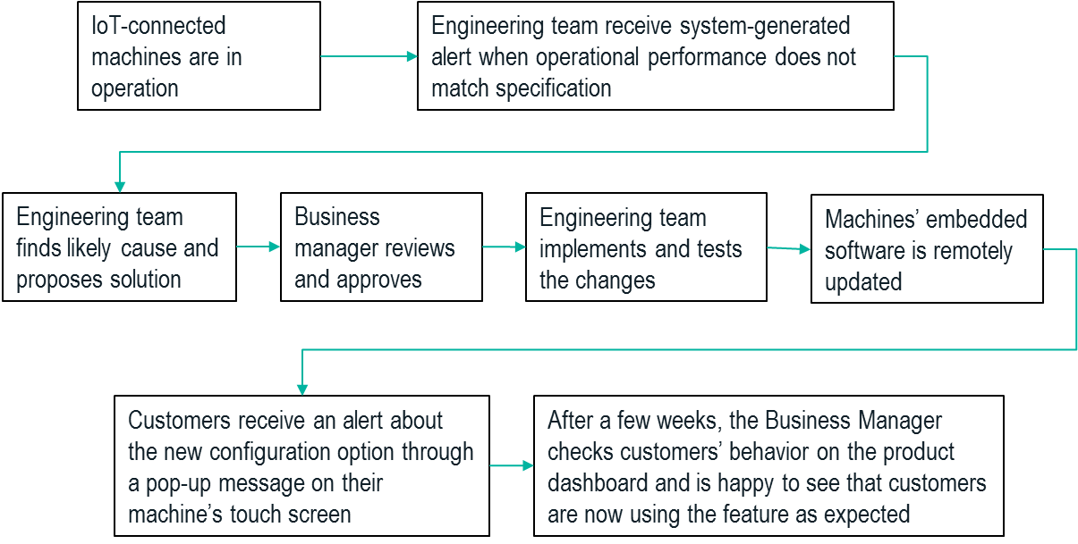
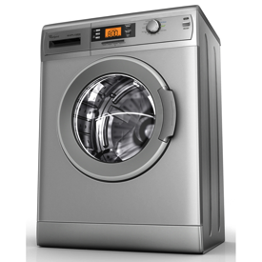
JKE Appliances introduced a new Low Flow Washing Machine to increase revenue and market share
Wash in half the time with half the energy and water
Competitive differentiator
Notes:
JKE Appliances recently introduced a new model that washes clothes in half the time with half the energy and water. These machines are a competitive differentiator, and JKE Appliances executives believed this model will help them to grow their market share significantly.

Slide 25
JKE Appliances “designed IoT in” so they could take advantage of the IoT feedback loop
Designed with Continuous Engineering
The business team identified KPIs
The engineering team defined and tested “plant model”
Sensors in the machines collect the data for both and to adjust system behavior automatically
Data sent to IBM IoT Platform
Notes:
JKE Appliances “designed IoT in” so they could take advantage of the IoT feedback loop. The washing machines is an IoT connected device utilizing IBM Watson IoT platform. Sensors in the machine collect data that are used to adjust system behavior dynamically as well as send the data to the IBM IoT Platform in the cloud to provide operational visibility and insight to JKE Appliances teams (both business and engineering teams).
The business team identified KPIs as part of the business planning and requirements process
The engineering team defined and tested a machine “plant model” during development
Automatic alerts based on the KPIs and plant model help the business and engineering teams to respond quickly if needed
An IoT Dashboard provides a portal for both teams

Slide 26

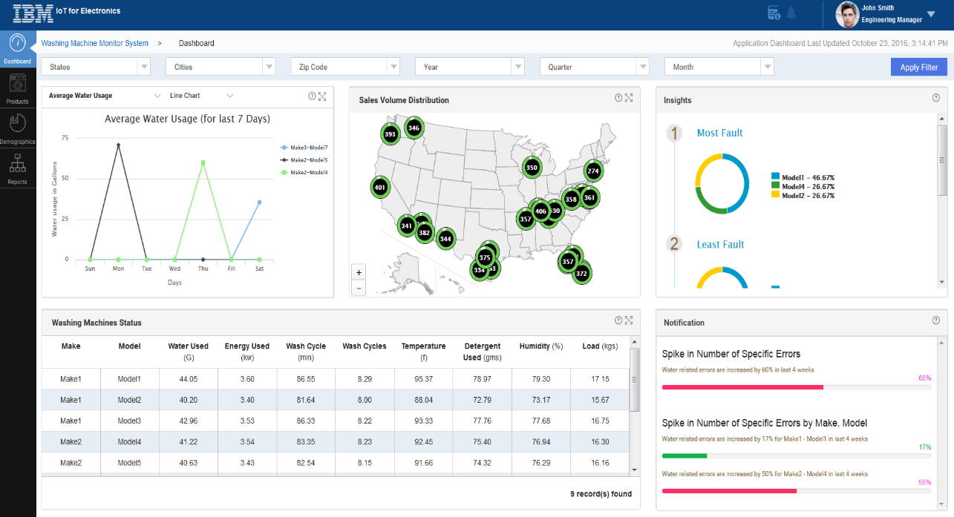
The engineering and business teams use IoT Dashboard to understand machines in operation
OSLC
The IoT Platform collects and analyzes data from the machines and other sources
Automatic alerts for business and engineering teams, so they can respond quickly
The IoT Dashboard to explore system operation, utilization and correlations
Status
Location by region
Usage times and modes
User sentiment
Notes:
IoT Dashboard as information radiators
Teams are using IoT Dashboard to monitor the status of all connected washing machines. This server as information radiator showing where the machines are, their breakdown by regions, average water usage, make and models, other detailed information collected from each machine, notification status, etc.

Slide 27
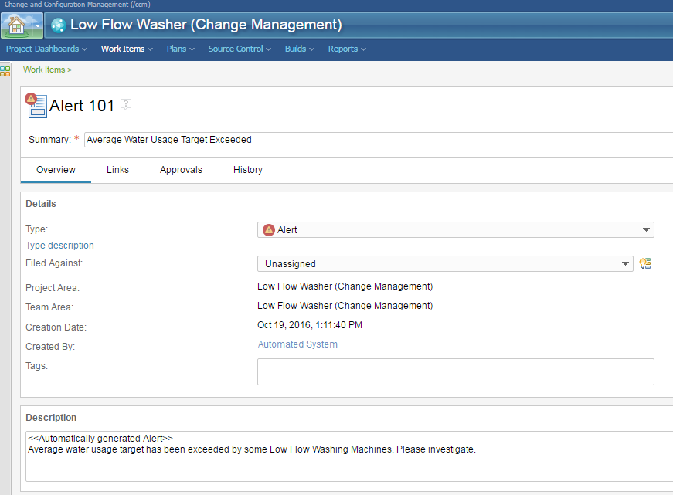
After two months of operation, the engineering team receives an alert indicating average water usage is exceeding its target in some regions
The IoT Platform raises an alert as the Average Water Usage exceeded 40 liters per load
An IoT Platform rule automatically creates an engineering work item to notify the team that an operational requirement is not being met
Notes:
After the first two months of operations, the JKE Appliances engineering team receives an alert indicating average water usage is exceeding the design target in some regions. The IoT Platform automatically created the alert (RTC work item) to let the team know that an operational requirement is not being met during actual production operation. The alert connects real-time operations with development providing early notification of issues in the field before they result in service calls, warranty repairs, lost sales, and/or decreased market share.

Slide 28
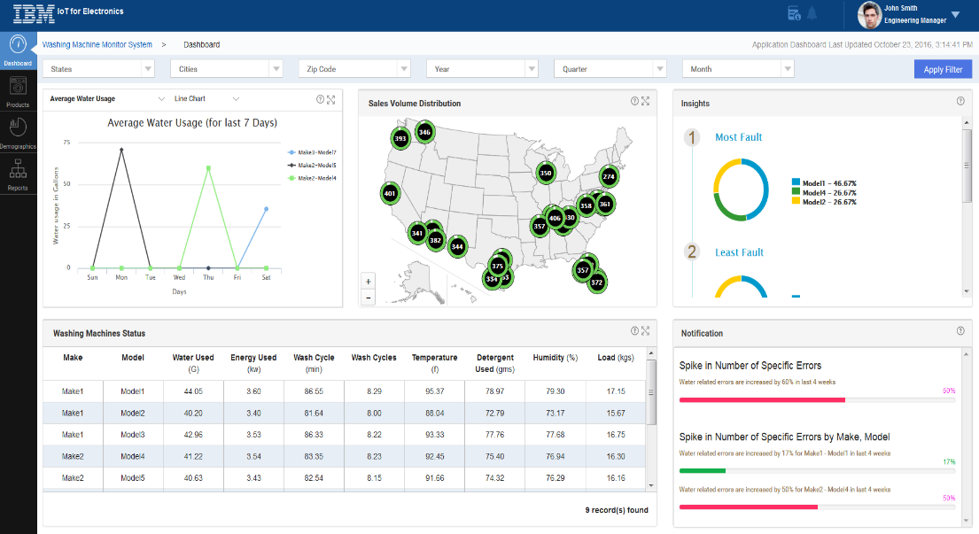
Using the IoT Dashboard, the engineering manager discovered that the issue is occurring in areas with exceptionally cold water
IoT Dashboard shows sensor values:
Average water usage target
Cold rinse water temperature is causing excessive detergent residue on clothes
High average water usage is caused by users manually adding additional full rinse cycles
Notes:
Root Cause Analysis
Elizabeth, JKE Appliances Engineering Manager, is notified of the Average Water Usage Target Exceeded alert. She uses the LFMW Monitoring System and the existing requirements and test cases to do initial root cause analysis. The LFMW Monitoring System dashboard provides washer cycle data, rinse water temperature, and other information directly from the devices that Elizabeth needs to analyze the problem. The operations dashboard shows that the average water usage target is not being met in several regions. KPIs in regions with failing the average water usage also have exceptionally cold rinse water. She concludes that very cold rinse water temperature could be leaving excessive detergent residue on clothes, and the high average water usage is caused by users manually adding additional full rinse cycles. She creates a work item Low flow washer does not adequately rinse the clothes to explore possible solutions.

Slide 29
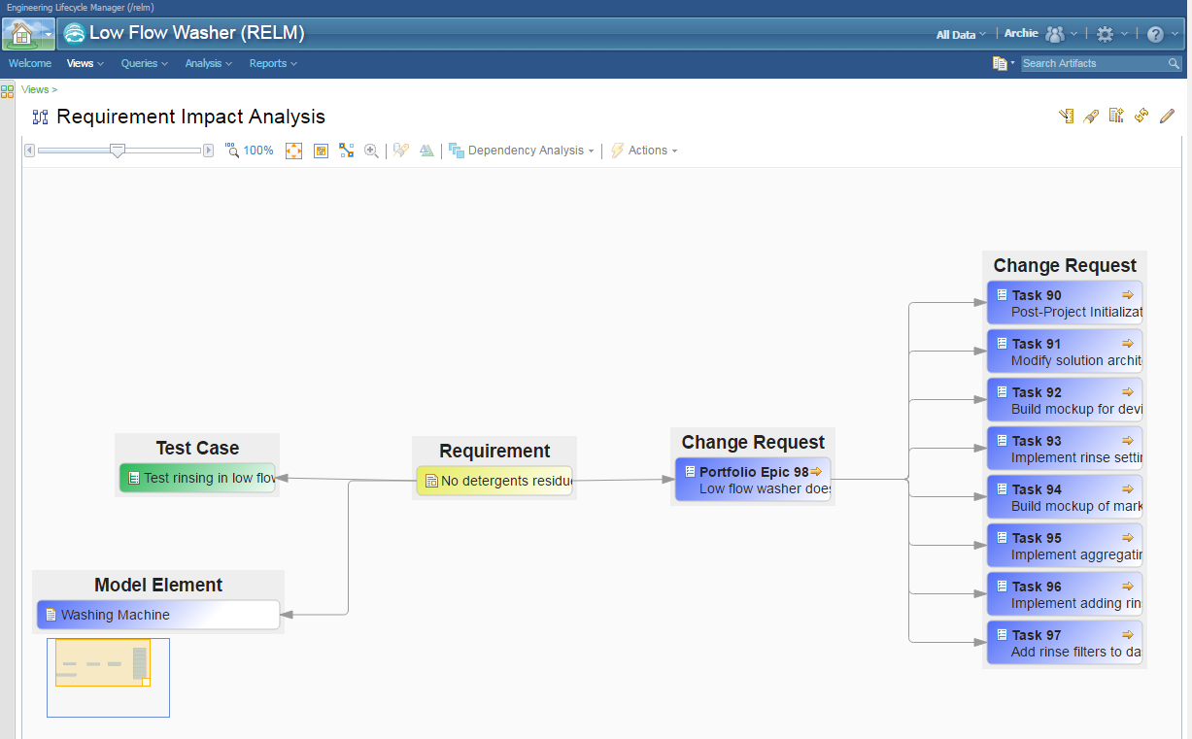
Engineering Manager explores how they missed this during development and QA
I thought we moved away from “a set of tests, only a few which failed”, since it adds a complication and is not easy to show in RQM UI (can you define a test or test plan as successful if 95% of the test steps or test cases pass? I’m don’ think so.
Traced the requirement to the related test cases and examined results
Test case did not account for excessive cold water temperature since temperature information was not available during development
Design for the Low Flow Washer is not sufficient for regions with very cold water
Notes:
Elizabeth reviews why the Low flow washer does not adequately rinse the clothes work item and does some initial analysis in order to determine a possible solution. She uses Requirement Impact Analysis to see that the Low Flow Washing Machine had a No detergent residue requirement that was tested during development by Test Case “Test rinsing in low flow mode”. However, this test case did not account for excessively cold rinse water temperature since accurate water temperature information was not available during development. Elizabeth concludes that the rinse cycle design for the Low Flow Washer is not sufficient for regions with very cold water.

Slide 30
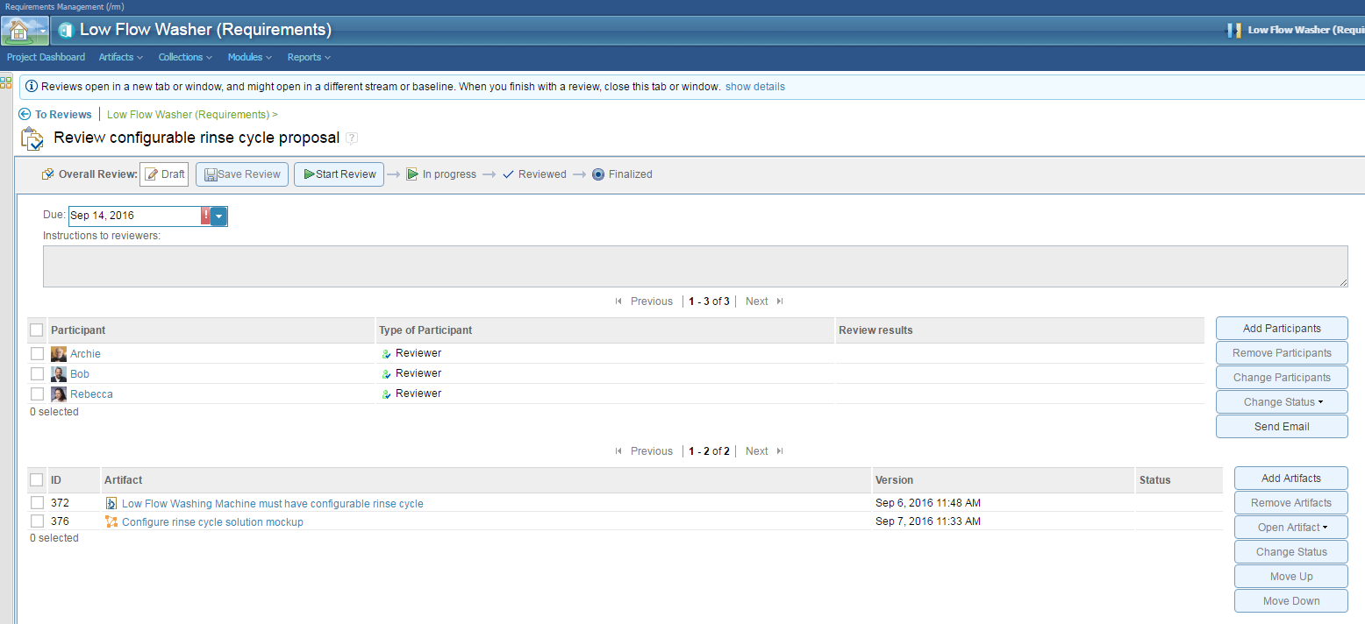
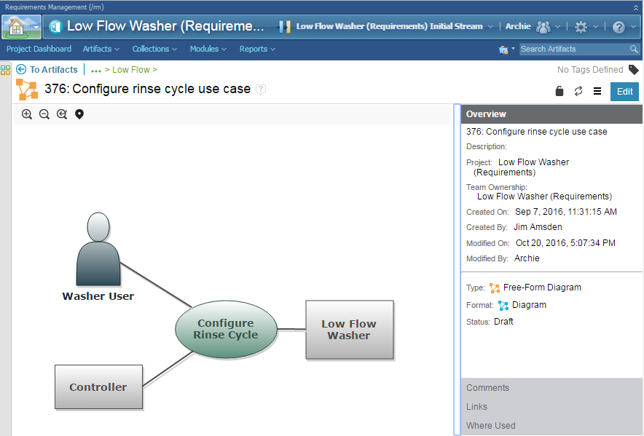
The engineering team reviews the design and proposes a solution which is approved
Proposal to use multiple, shorter rinse cycles in regions with extreme cold water
Update an existing requirement and related test criteria
Team reviews updates, and performs on-line review/approval
Notes:
Elizabeth determines a potential solution is to use multiple, shorter rinse cycles in these regions, with the number of rinse cycles computed from the rinse water temperature reading, with an option for users to set a preferred number of rinse cycles. She captures this proposal in additional requirements with a mock-up of the solution, and then schedules a requirements review to see if this solution is acceptable.

Slide 31
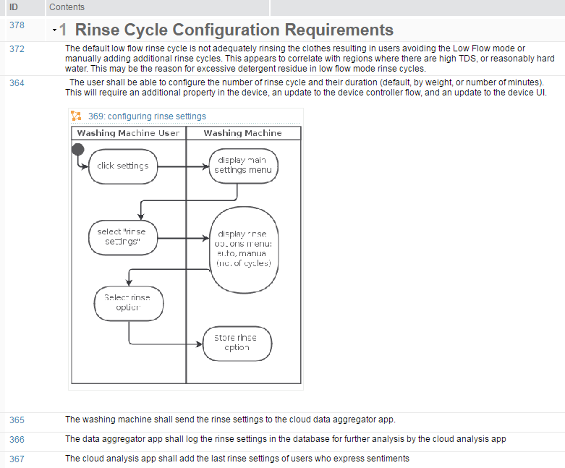
Engineering team does design analysis and elicit additional requirements for impacted solution components
Design view and its associated rules and application used to determine additional implementation details
A new washer property needed
Use suspect links to see impact of adding new property
They agree: significant potential business impact; must act quickly.
Notes:
Now that the requirements for the proposed solution have been approved, Elizabeth does design analysis of the Low Flow Washer to determine how the requirements should be implemented. She uses a design view of the washing machine device and its associated rules and applications to determine any additional detailed requirements that should be met. Her analysis uncovers a number of new requirements to Support configurable rinse cycle. These requirements are all organized in a Low Flow Rinse Cycle Requirements module

Slide 32
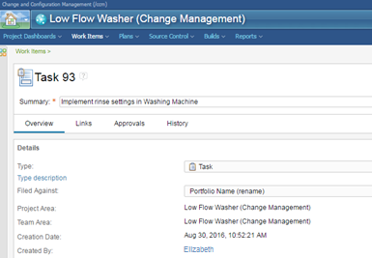
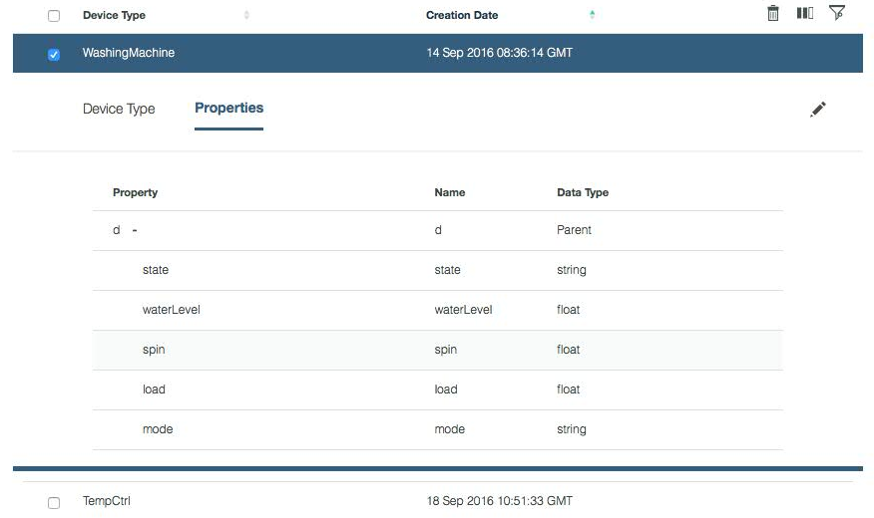
The development team implements changes in the embedded software and the IoT application
Embedded systems developer implements the approved changes by adding a new property to the washing machine and other solution components (IoTP, Node-RED flows, etc.); builds new firmware
Test team verifies the solution
Firmware ready for delivery to the washing machines
Notes:
The development team has completed iteration planning and moved work items from the project backlog into the iteration and assigned them to developers. A develop, Devon, opens a work item, Implement rinse settings in Washing Machine, assigned to him and explores the associated requirements and design in order to determine how to implement the requirements. He determines the best implementation is to add a new property to the washing machine device to set the number of rinse cycles. He implements this new property in the IoT Platform and sees the implementation automatically reflected in the updated washing machine design. He then does further change and impact analysis in order to determine the impact of the new property. This analysis indicates that the washing machine UI and controller need to be updated to allow users to set the desired number of rinse cycles, and for the washer controller to execute them. Devon uses suspect links between requirements and design elements to help guide his analysis and determine when his work is complete.

Slide 33
The update was deployed to selected Low Flow machines, and JKE Appliances used IoT data to confirm that the update solved the problem
The firmware update is made available to machines in affected areas (limited roll-out)
A pop-up on the touch screen alerts users:
“Better rinsing now automatic”
“Try it tweet your results with #LowFlowWasher to enter drawing for Amazon gift card”
After two weeks the business manager checks the IoT Dashboard to confirm problem is fixed
Notes:
The company used their IoT to detect a problem before it resulted in costly warranty repairs, customer dissatisfaction, lost sales or market share
Good change management and dependency management simplified the analysis and development process
The solution was delivered in a software update – no service call required
Customers received a new capability in their machines through a remote software update
The company encouraged client engagement on Twitter, which helped them to monitor customer satisfaction

Slide 34
With connected products you can …
Monitor products in operation
Engage clients in new user experience
Create new business models and revenue streams
Test business assumptions
Client usage patterns (features used, path through features, location and time of use, etc.)
Test technical assumptions
Product operational / plant model
Operating environment
Component out of tolerance / likely failure
Delight your customers
Reach new customers
Cross-sell to customers
Lower customers’ costs
Sell products as a service
Which makes it possible to …
Understand customer behavior and product usage
Identify new product or business opportunities
Reduce warranty and repair cost
Improve customer satisfaction
Identify design optimizations
Differentiate your offerings
Build brand loyalty
Understand customers
Identify new product or business opportunities
Grow revenue and market share
Turn one-time sales into revenue stream annuities
Which makes it possible to …
IoT feedback loop
Notes:
We are going to look at a scenario today that addresses the green items

